Slide 1

Socio Analyzer
Team MI 7
Abhijeet Agrawal
Durga Charan Potukuru
Krishna Veni Karri
Srinivas Prakash Pakala
Sai Praneetha Jaladanki
Vipul Chandoor

Slide 2

Client
Dr. Kyoung-Ho Shin
Professor in Health Science and Wellness
Northwest Missouri State University
Ph.D. Sociology
Kansas State University, 1999

Slide 3

Outline
Introduction
Problem statement
Proposed solution
Tools and techniques
Workflow
Sentiment analysis
Demo
Future tasks
Limitations

Slide 4
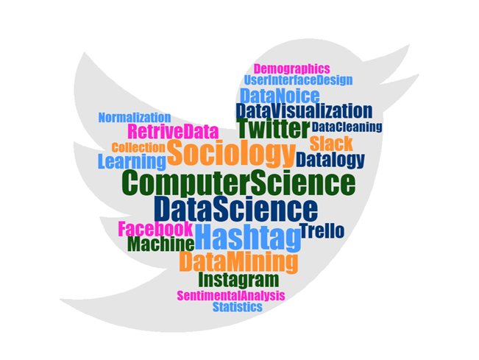
Introduction
A social issue is a problem that influences a considerable number of the individuals within a society
Study of people’s reaction on different social issues
By integrating the data science with sociology, we can analyse the huge data by using Machine learning algorithms.
Praneetha Jaladanki
Notes:
Talk to social issues, movements

Slide 5

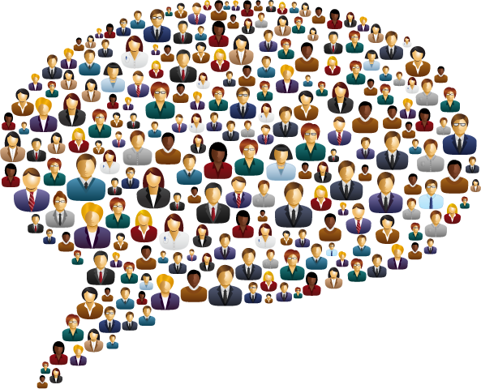
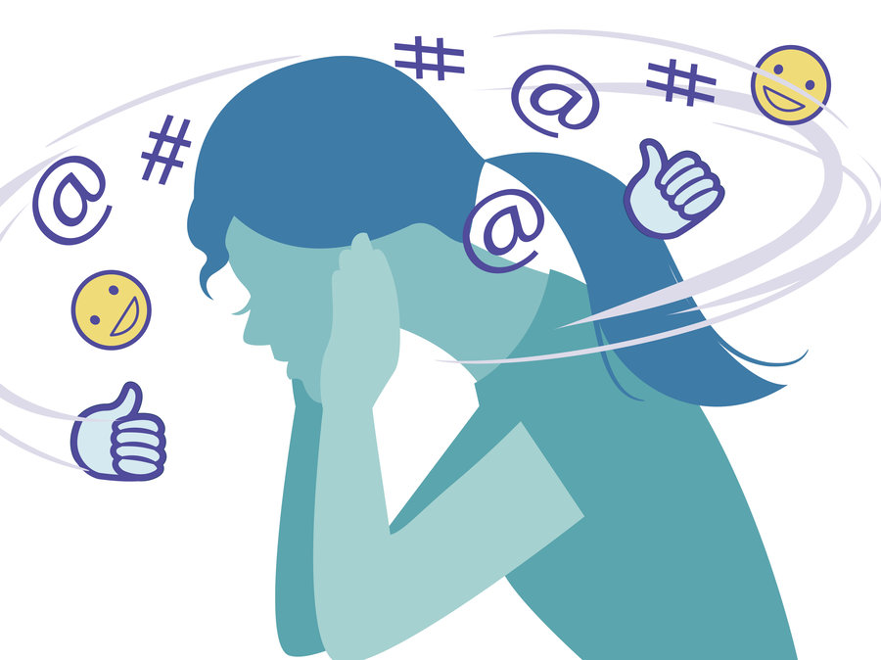

Problem statement
Interviewing
People’s opinions
Polls and surveys
Praneetha Jaladanki
Notes:
Hide things, example social moments

Slide 6


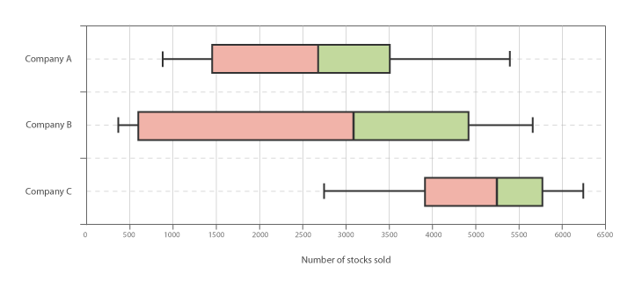
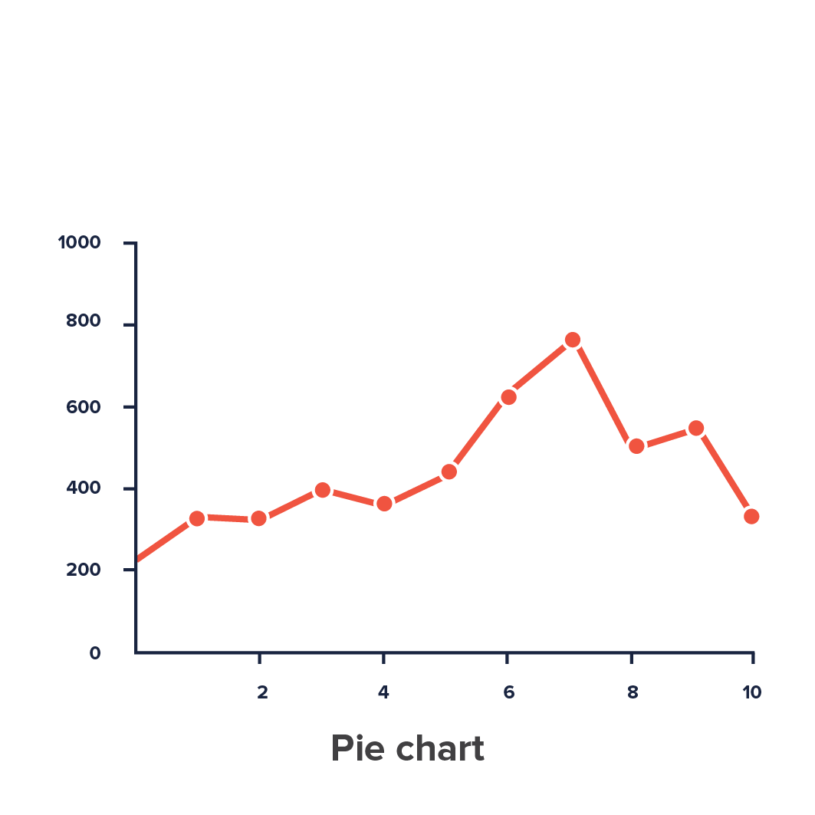
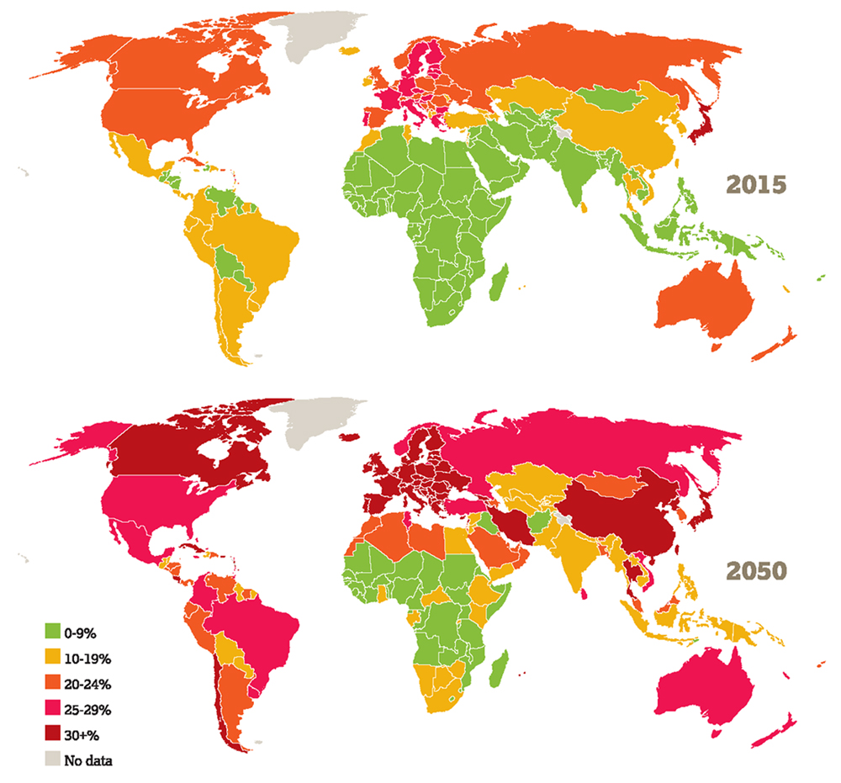
Proposed solution
Emotions
Twitter
Hashtag
Reports
Praneetha Jaladanki

Slide 7




Tools and technologies
Frontend
Backend
Data Analysis
Nodejs
Python
Angular
MongoDB
Krishnaveni Karri

Slide 8






Other tools
Github
Google docs
Canvas
D3.js
Trello
Slack

Slide 9
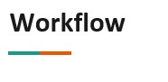
Input: Collection of tweets
Output: Processed Collection of tweets
Technology used: Python re library
Collect tweets
Preprocess data
Sentiment analysis
Input: Processed Document of tweets
Output: Collection of tweets with additional metrics
Technology used: Python libraries and APIs
Input: Hashtag and date
Output: Collection of tweets
Technology used: Python tweepy library
Krishnaveni Karri

Slide 10
Store Data
Design APIs
Develop UI
Output: API endpoints
Technology used: Python flask API
Input: Collection of tweets with additional metrics
Output: JSON objects of tweets
Technology used: Mongodb, Python Mongoose engine
Output: Simple User Interface with filters and options
Technology used: AngularJS
Krishnaveni Karri

Slide 11


Sentiment Analysis APIs
Text Blob
Parallel dots
Aylien
Abhijeet Agrawal

Slide 12
Sentiment analysis
S. No | Text | Polarity
1 | I love this sandwich | Positive
2 | This is an amazing place! | Positive
3 | I feel very good about these beers | Positive
4 | This is my best work | Positive
5 | What an awesome view | Positive
6 | Tomorrow is Wednesday | Neutral
7 | I am tired of this stuff | Negative
8 | I can't deal with this | Negative
9 | He is my sworn enemy! | Neutral
10 | I am here | Neutral

Slide 13

Sentiment analysis with Textblob
Python library for processing textual data
Metrics :
Subjectivity
Opinion respective of the topic
Range : [ 0 to 1 ]
0 - Non-subjective
1 - Subjective
Polarity
Emotion for the text
Range: [ -1 to 1 ]
-1 : Negative 0: Neutral 1 : Positive
Classifier Role
Abhijeet Agrawal
Notes:
AA
Write scale 0 n 1
definitions

Slide 14
Sentiment analysis - Textblob
S. No | Text | Polarity | Polarity values | Subjectivity values
1 | I love this sandwich | Positive | 0.50 | 0.60
2 | This is an amazing place! | Positive | 0.75 | 0.90
3 | I feel very good about these beers | Positive | 0.90 | 0.78
4 | This is my best work | Positive | 1.00 | 0.30
5 | What an awesome view | Positive | 1.00 | 1.00
6 | Tomorrow is Wednesday | Neutral | 0.00 | 0.00
7 | I am tired of this stuff | Negative | -0.40 | 0.70
8 | I can't deal with this | Negative | 0.00 | 0.00
9 | He is my sworn enemy! | Neutral | 0.00 | 0.00
10 | I am here | Neutral | 0.00 | 0.00

Slide 15

Sentiment analysis with ParallelDots
Uses Long Short Term Memory (LSTM) algorithms and Recurrent Neural networks for generating the sentiment.
Metrics : In percentages
Positive
Negative
Neutral
Durga Charan Potukuru
Notes:
DCP

Slide 16
Sentiment analysis - Parallel dots
S. No | Text | Positive (%) | Negative(%) | Neutral(%)
1 | I love this sandwich | 99.2 | 0.2 | 0.6
2 | This is an amazing place! | 99.4 | 0.2 | 0.4
3 | I feel very good about these beers | 98.5 | 0.1 | 1.4
4 | This is my best work | 95 | 2.6 | 2.4
5 | What an awesome view | 99.4 | 0.1 | 0.5
6 | Tomorrow is Wednesday | 35.4 | 27.2 | 37.4
7 | I am tired of this stuff | 1.2 | 98.1 | 0.7
8 | I can't deal with this | 0.2 | 97.3 | 0.7
9 | He is my sworn enemy! | 10.6 | 62.1 | 27.4
10 | I am here | 2 | 1 | 97

Slide 17

Sentiment analysis with Aylien
Aylien uses Natural Language Processing tool.
Text Analysis API
Metrics :
Polarity :
Positive
Negative
Polarity Scale : [ 0 to 1 ]
Subjectivity Scale : [ 0 to 1 ]
Vipul Chandoor
Notes:
VC

Slide 18
Sentiment analysis - Aylien
S. No | Text | Polarity | Polarity values | Subjectivity values
1 | I love this sandwich | Positive | 0.99 | 1.0
2 | This is an amazing place! | Positive | 0.99 | 0.96
3 | I feel very good about these beers | Positive | 0.87 | 1.0
4 | This is my best work | Positive | 0.79 | 0.99
5 | What an awesome view | Positive | 0.98 | 0.60
6 | Tomorrow is Wednesday | Neutral | 0.54 | 0.54
7 | I am tired of this stuff | Negative | 0.95 | 1.0
8 | I can't deal with this | Negative | 0.55 | 1.0
9 | He is my sworn enemy! | Positive | 0.42 | 1.0
10 | I am here | Neutral | 0.44 | 1.0

Slide 19
Sentiment analysis - Result
S. No | Text | Manual | Textblob | ParallelDots | Aylien
1 | I love this sandwich | Positive | Positive | Positive | Positive
2 | This is an amazing place! | Positive | Positive | Positive | Positive
3 | I feel very good about these beers | Positive | Positive | Positive | Positive
4 | This is my best work | Positive | Positive | Positive | Positive
5 | What an awesome view | Positive | Positive | Positive | Positive
6 | Tomorrow is Wednesday | Neutral | Neutral | Neutral | Neutral
7 | I am tired of this stuff | Negative | Negative | Negative | Negative
8 | I can't deal with this | Negative | Negative | Negative | Negative
9 | He is my sworn enemy! | Neutral | Neutral | Negative | Positive
10 | I am here | Neutral | Neutral | Neutral | Neutral

Slide 20
Sentiment analysis - Conclusion
Use Textblob API
Benefits of Textblob:
Python library (Installed as a Package)
Custom classifier
Language translation and detection
Srinivas Pakala
Notes:
VC

Slide 21
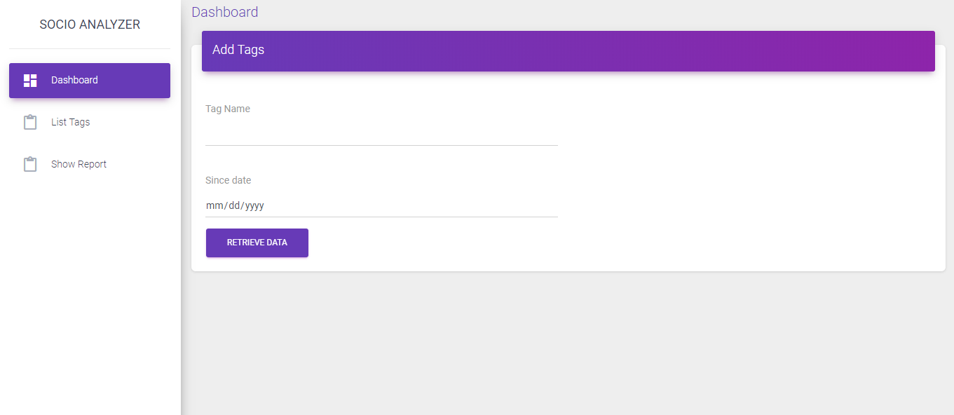
Demo
Resource URL: https://gdp-ui.herokuapp.com/
Srinivas Pakala
Notes:
SP

Slide 22

Future tasks
Tasks scheduled | Status of the task
Sentiment analysis | Done
Frontend development | In-Progress
Database design and connectivity | In-Progress
Data visualization | Not yet started
Srinivas Pakala
Notes:
SP

Slide 23

Limitations
No access to demographic data like age of the person, location, gender etc.
Expensive historic data
Cannot retrieve data from other social media
Storage of historic data
Srinivas Pakala

